Slide 1
What’s Ahead for Rayne Church
7th April 2024

Slide 2
Rayne church is launching a new choir and music group to sing at the Communion service on the 4th Sunday each month. All welcome. Practice time to be agreed.
Please contact Gloria and Paul at gloria@arriveontime.com.au or call 07518618157

Slide 3
Meets in this church monthly
Next one is Wednesday 17th April.
See Bernie if you are interested.

Slide 4
Family Film in Rayne church

Slide 5
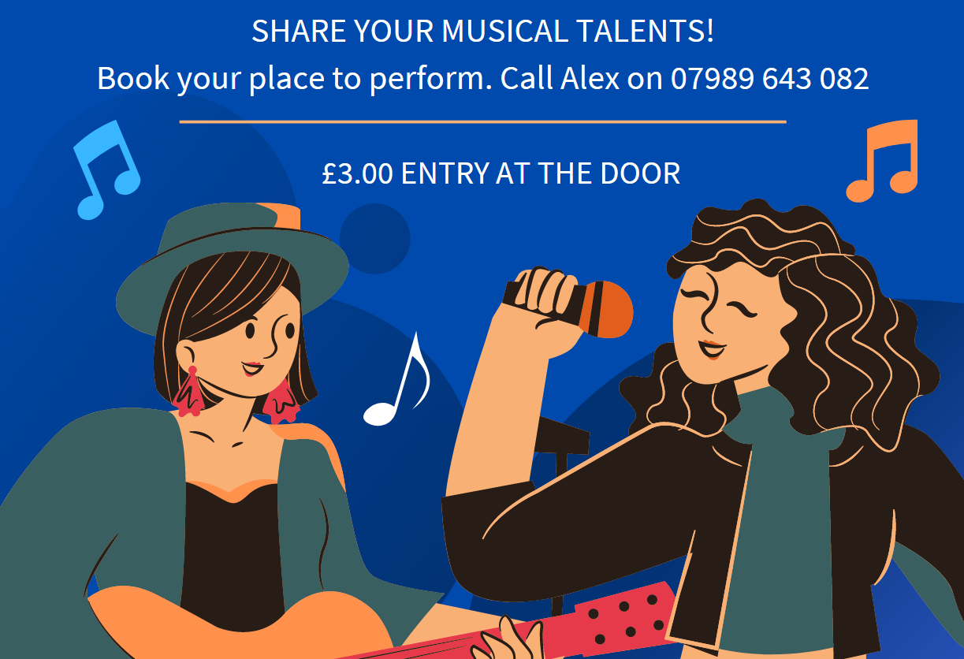

Slide 6
Lunch Club
On second Thursday of the month, home cooked two course lunch, juice to start and tea/coffee £6. Speak to Kate to book a place.
April 11th | Home baked gammon, new potatoes and veg | Chocolate or sticky toffee pudding with chocolate sauce or toffee sauce and ice cream

Slide 7
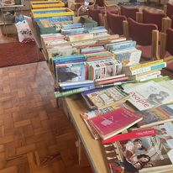
Table-Top Sale
Books , puzzles and bric a brac
Sunday 28th April
11am -4pm
Rayne Church
Refreshments
All proceeds to support the work of Neil and Sue Browning for the Church Missionary Society (CMS)

Slide 8
A Time To Be
This is a slow, simple, contemplative service with silences, a reading and Taizé music.
Every 4th Sunday. Here in the church

Slide 9
Great Dunmow Town Band Presents
Saturday 15th June 2024
5pm until 7pm
The Church in Great Notley
in aid of Braintree Area Foodbank
A Night of the Stars
Tickets £10 (under 16's free of charge)

Slide 10
Could you help, please?
e.g.
Coffee/tea makers after services
Side-persons to greet worshippers
Cleaning the church
Joining our PCC
Please speak to our church wardens, Colin & Graham

Slide 11
Did you know we have a hearing aid loop?

Slide 12
Sunday Services: all at 9.30 am
1st Sunday: Morning Prayer
2nd Sunday: All-Age Worship
3rd Sunday: Modern Communion
4th Sunday: Traditional Communion
5th Sunday: Communion in one of our 3 benefice churches
All welcome

