Slide 1

What’s Ahead for Rayne
Church
15th February 2026

Slide 2

Wednesday mornings in Rayne church
10 a.m.

Slide 3

Ash Wednesday Service
10 a.m. 18th Feb

Slide 4


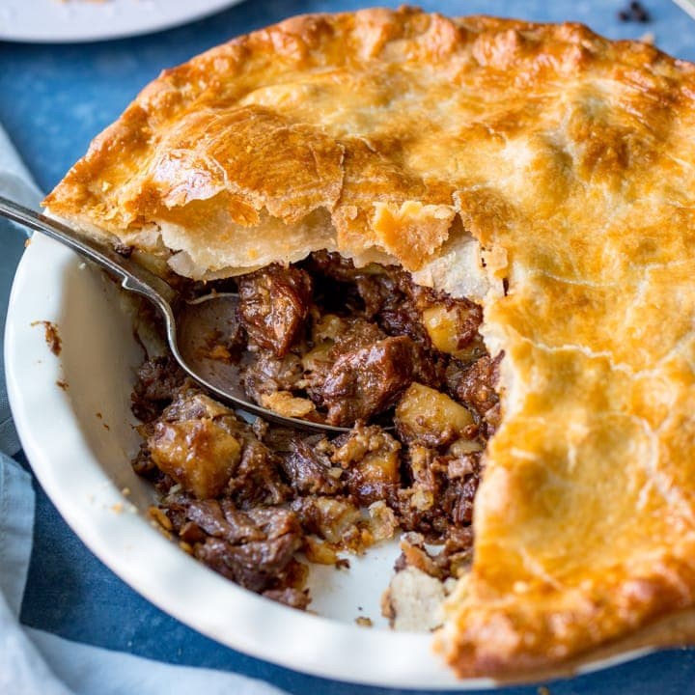

Lunch Club
Thursday 5th March 2026
12.00 for 12.30 £7
Speak to Kate to book a place
Steak pie, new potatoes and veg. Fruit pavlova

Slide 5
Weekly Lunch Club
Is also on every Thursday in the Old Schoolroom at 12 noon.
~Friendly chat, soup, choice of 4 sandwiches made to order and cake or dessert. Light- hearted quiz. Very easy going. No need to book.
Only £5 per head

Slide 6


Slide 7

KNEAD
Bread making
Saturday 7th march 10am to 12 noon
We are making bara brith
Speak to kate to book a place

Slide 8


Slide 9
We urgently need a new editor for Rayne in Focus to take over from Linda Taylor.
Do you know of anyone who could take on this role from August onwards ?
Please speak to any of the ministry team if you have an idea

Slide 10
Rayne Sunday Services: all at 9.30 am
1st Sunday: Communion with choir
2nd Sunday: All-Age Worship
3rd Sunday: Communion
4th Sunday: Morning Prayer
5th Sunday: Benefice Service in one of the 3 churches
Everybody is welcome

Slide 11

to London by coach
See the information in your newsletter

