Slide 1


What’s Ahead for Rayne Church?
^{28th September 2025}

Slide 2
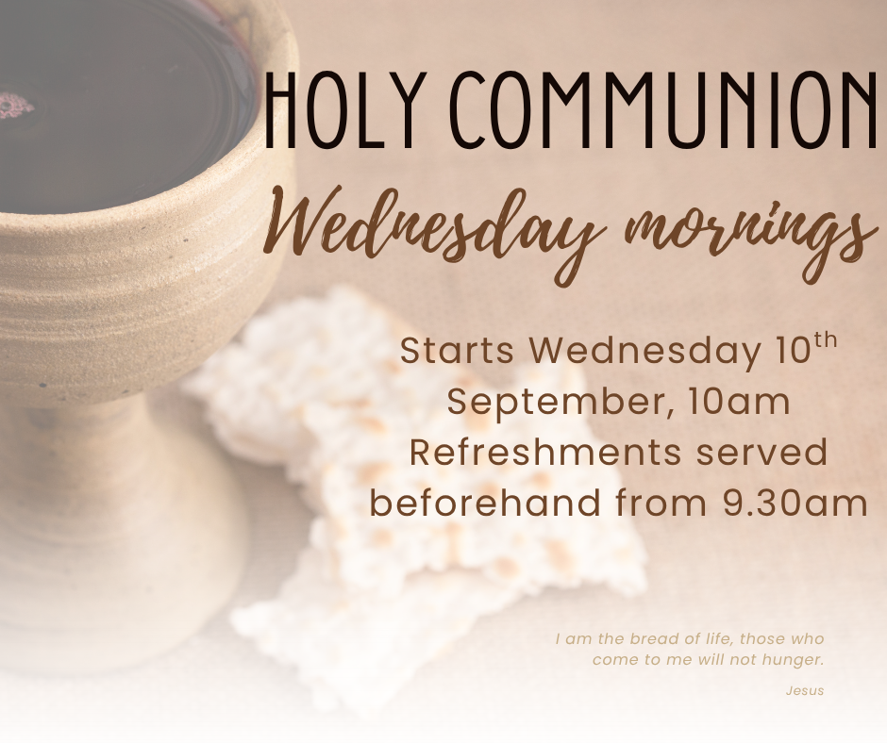

Slide 3


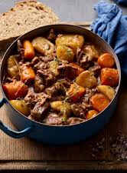
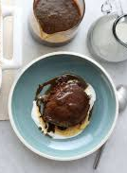
Lunch Club
Thursday 10th October
12 for 12.30
Beef Casserole and Sticky Toffee Pudding
£6
All welcome, speak to Kate to book a place
Thurs 9th October

Slide 4
Weekly Lunch Club
Is also on every Thursday in the Old Schoolroom at 12 noon.
~Friendly chat, soup, choice of 4 sandwiches made to order and cake or dessert. Light- hearted quiz. Very easy going. No need to book.
Only £4 per head

Slide 5


Slide 6
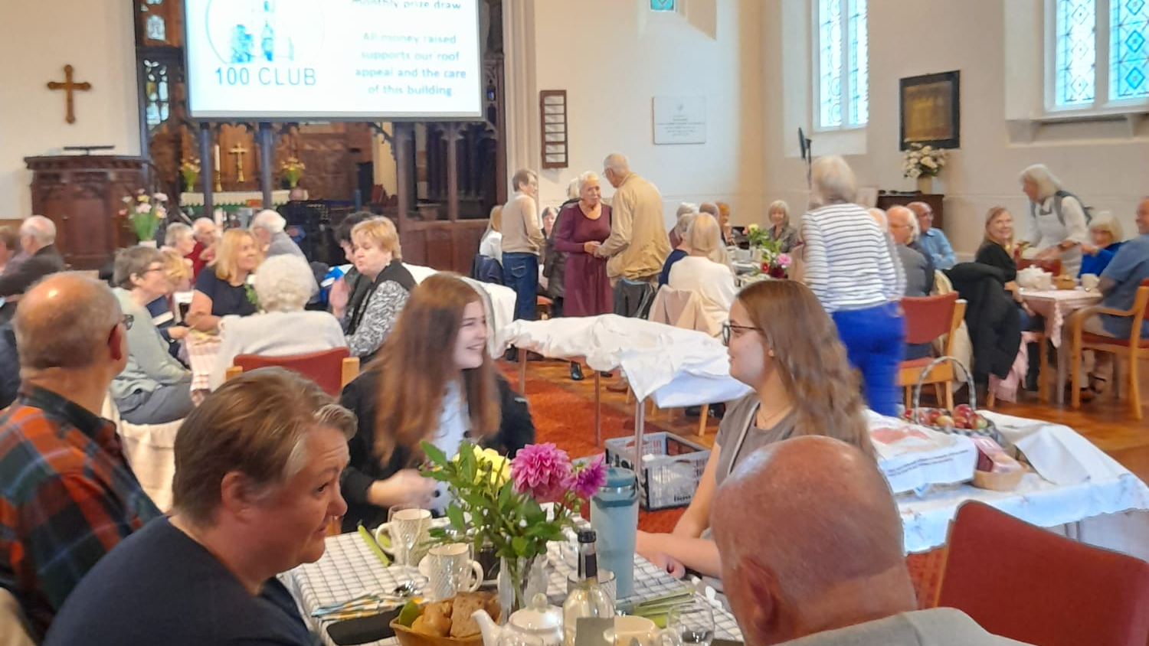
Yesterday’s Harvest tea raised £724 for our roof

Slide 7

Starts this Wednesday 1st October

Slide 8
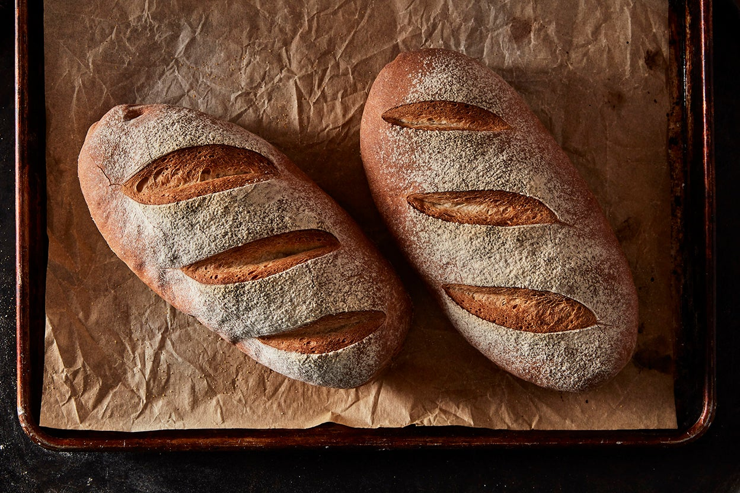
Knead next meets on 11th October from 10am to 12 noon in Rayne Church
All welcome
£ 4 (Under 16s free)
We will be making gluten free bread and a
Harvest wheatsheaf by joint enterprise
We will be making foccacia
This Photo by Unknown Author is licensed under CC BY-SA

Slide 9
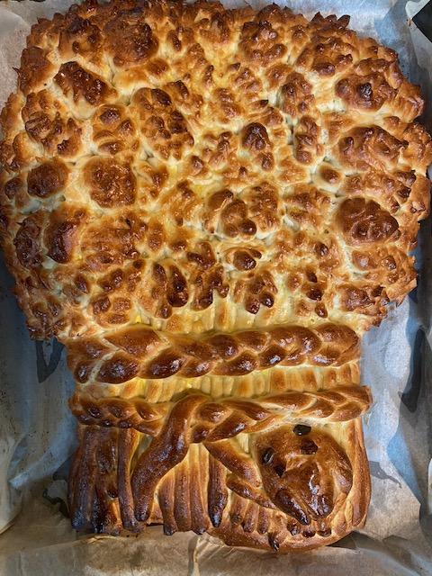
Help support Braintree Area Foodbank at our All-age Harvest festival on October 12th.
Donate an item or two from our shopping list ensuring we can provide food for people facing hardship in your community.
Shopping List:
Breakfast cereal
Milk (UHT or powdered)
Instant snacks i.e. pot noodle
Cup soups
Biscuits
Tinned fish
Tinned vegetables
Tinned rice pudding
Jam

Slide 10


TIME TO BE
Quiet contemplative worship
A Bible reading.
Prayer.
Music. (30 minutes)
28th September
4 p.m.
In this church

Slide 11
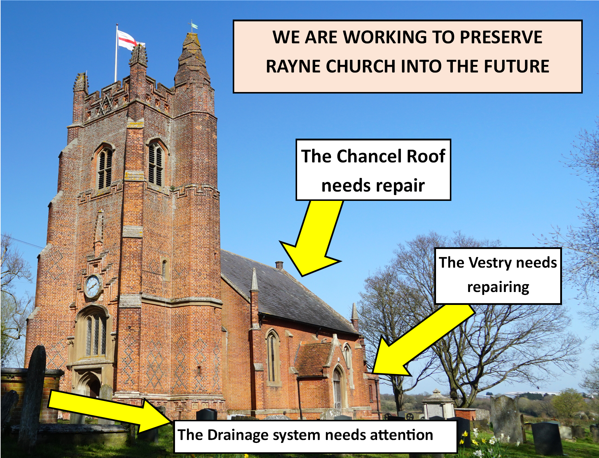

£130,000
So we need to find the money to support these things.

Slide 12

It’s never too late to join.
Money raised supports our roof appeal.

Slide 13

An editor is needed for Rayne in Focus, our parish magazine
Could you do this for us?
Please ask Rev’d Rachel, Nikki or Roman for more information

Slide 14
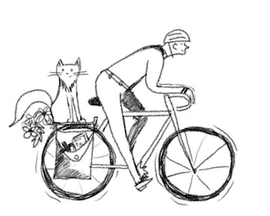
Pedal Power to keep the roof on our church
Rev Roman cycled over 50 miles and visited 29 churches to raise about £1,500 for Friends of Essex Churches and our roof appeal. Thank you for your kind sponsorship.

Slide 15
Rayne Sunday Services: all at 9.30 am
1st Sunday: Communion with choir
2nd Sunday: All-Age Worship
3rd Sunday: Communion
4th Sunday: Morning Prayer
5th Sunday: Benefice Service in one of the 3 churches
Everybody is welcome

