Slide 1


What’s Ahead for Rayne Church?
^{2nd November 2025}

Slide 2
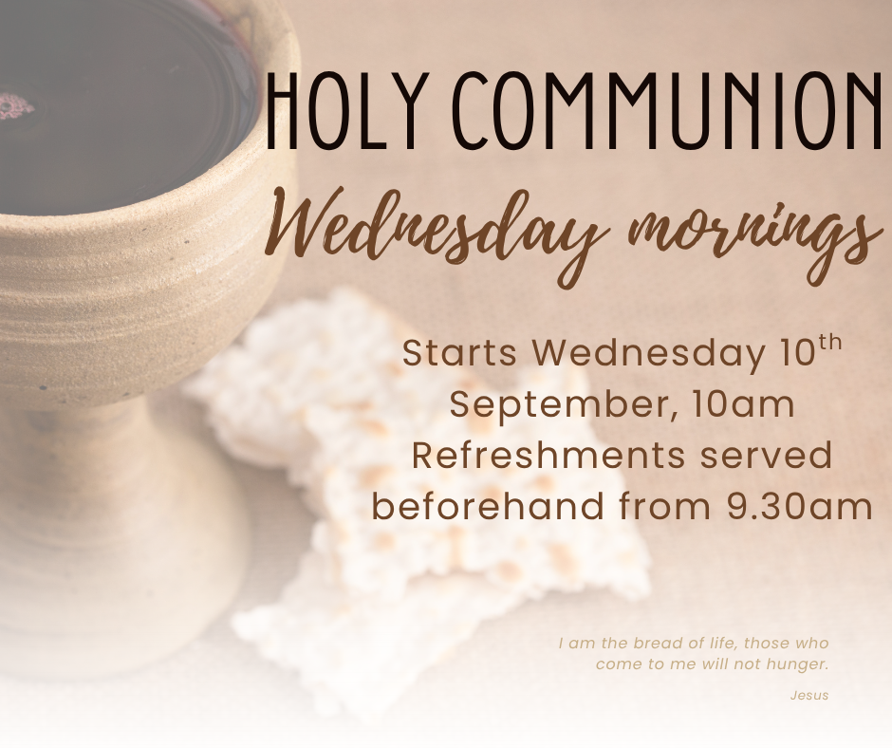

Slide 3


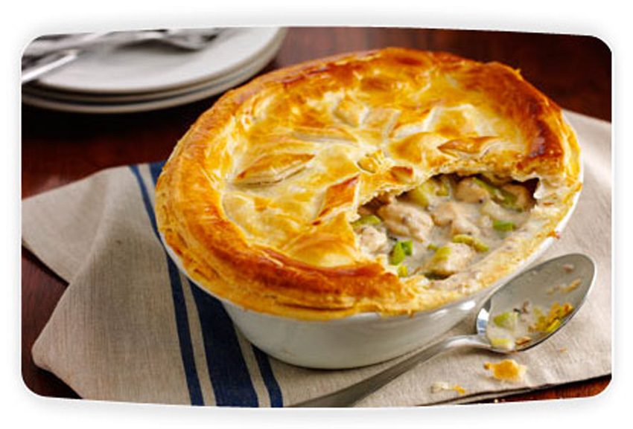
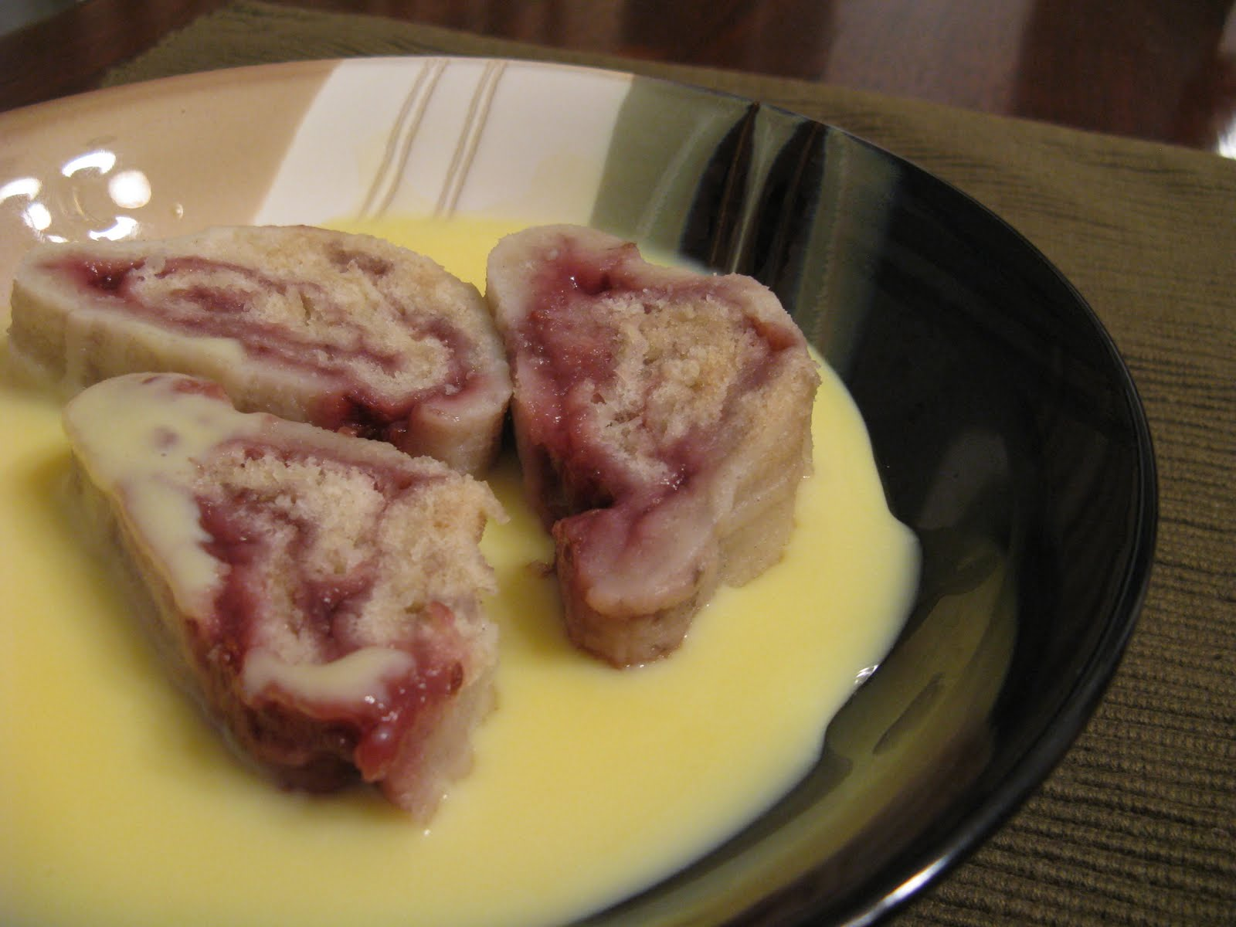
Lunch Club
Thursday 13th November
12 for 12.30
Chicken and ham Pie with seasonal vegetables and Jam Roly poly with custard £6
All welcome, speak to Kate to book a place
This Photo by Unknown Author is licensed under CC BY-SA
This Photo by Unknown Author is licensed under CC BY-SA-NC

Slide 4
Weekly Lunch Club
Is also on every Thursday in the Old Schoolroom at 12 noon.
~Friendly chat, soup, choice of 4 sandwiches made to order and cake or dessert. Light- hearted quiz. Very easy going. No need to book.
Only £4 per head

Slide 5


Slide 6
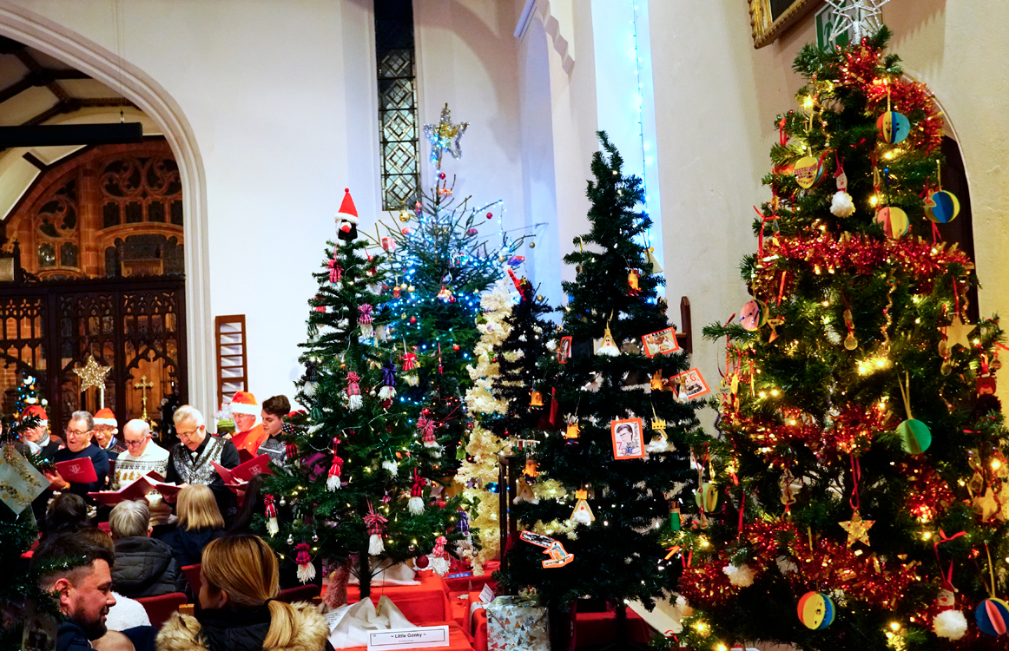
Our Christmas Tree Festival is on the weekend of 5th 6th and 7th December
Entering a tree is free and open to anyone
Just speak to Kate

Slide 7

Knead next meets on 8th November from 10am to 12 noon in Rayne Church
We are making naan bread
All welcome
£ 4 (Under 16s free)
We will be making foccacia
This Photo by Unknown Author is licensed under CC BY-ND

Slide 8
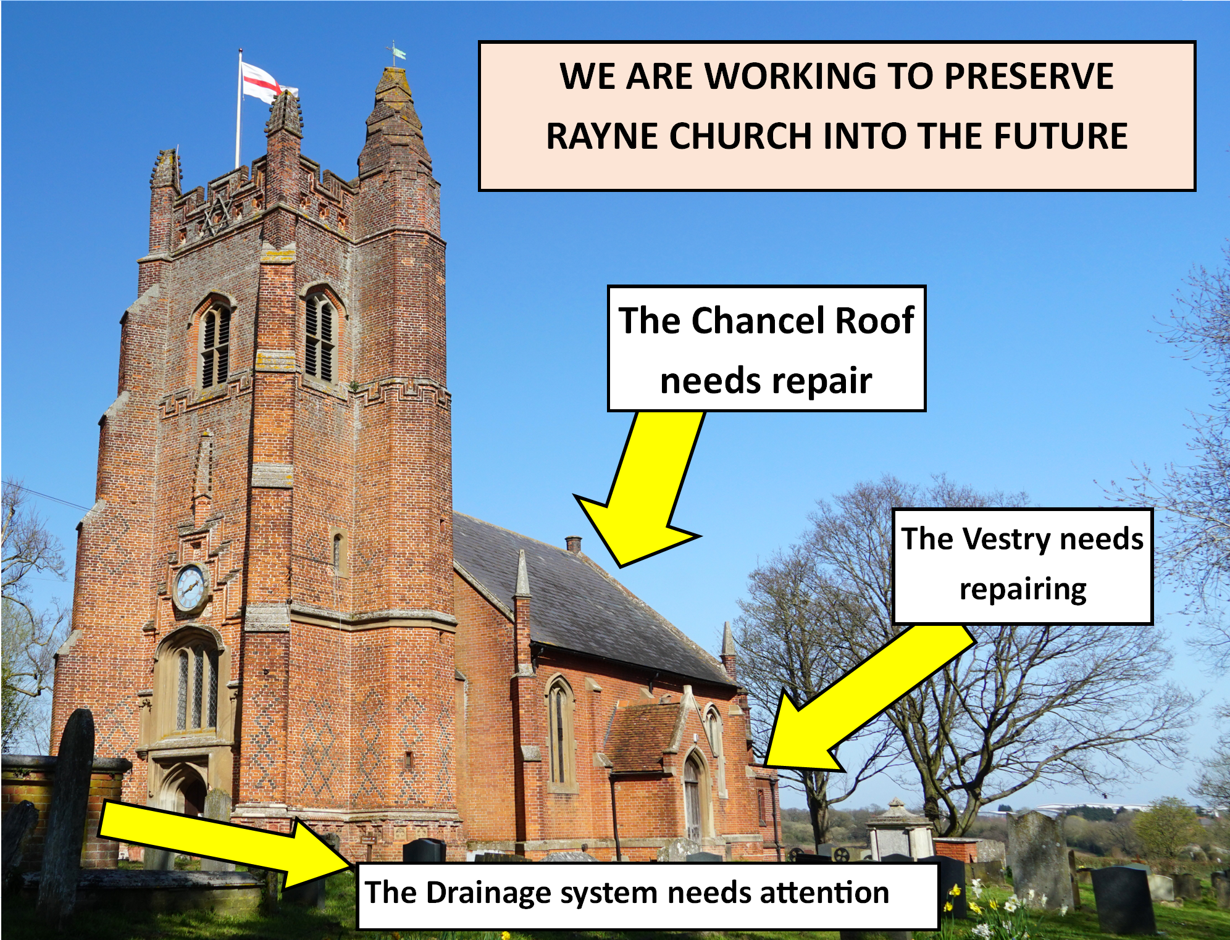

£130,000
So we need to find the money to support these things.

Slide 9

Please tell friends and neighbours about our 100 club.
Money raised supports our roof appeal.

Slide 10

An editor is needed for Rayne in Focus, our parish magazine
Could you do this for us?
Please ask Rev’d Rachel, Nikki or Roman for more information

Slide 11
Rayne Sunday Services: all at 9.30 am
1st Sunday: Communion with choir
2nd Sunday: All-Age Worship
3rd Sunday: Communion
4th Sunday: Morning Prayer
5th Sunday: Benefice Service in one of the 3 churches
Everybody is welcome

