Slide 1

What’s Ahead for Rayne
Church
5 April 2026

Slide 2

Wednesday mornings in Rayne church
10 a.m.

Slide 3
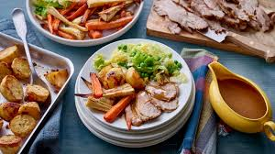
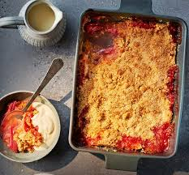
Lunch Club
Thursday 9th April 2026
12.00 for 12.30 £7
Speak to Kate to book a place
Roast loin of pork with stuffing apple sauce and seasonal vegetables
Fruit crumble and custard

Slide 4
Weekly Lunch Club
Is also on every Thursday in the Old Schoolroom at 12 noon.
~Friendly chat, soup, choice of 4 sandwiches made to order and cake or dessert. Light- hearted quiz. Very easy going. No need to book.
Only £5 per head

Slide 5


Slide 6
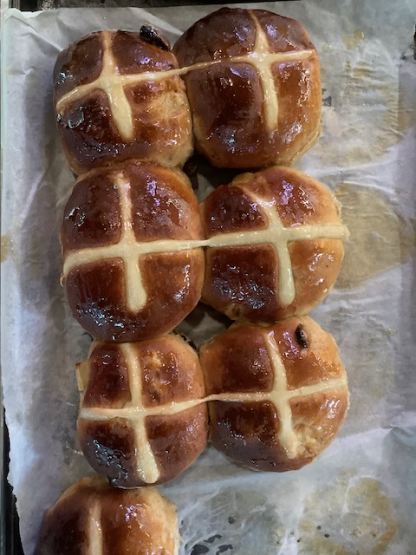

KNEAD
Saturday 11th April 10am to 12 noon
We are making Italian Easter Bread or hot Cross Buns
Speak to kate to book a place

Slide 7
We urgently need a new editor for Rayne in Focus to take over from Linda Taylor.
Do you know of anyone who could take on this role from August onwards ?
Please speak to any of the ministry team if you have an idea

Slide 8
Rayne Sunday Services: all at 9.30 am
1st Sunday: Communion with choir
2nd Sunday: All-Age Worship
3rd Sunday: Communion
4th Sunday: Morning Prayer
5th Sunday: Benefice Service in one of the 3 churches
Everybody is welcome

