Slide 1


What’s Ahead for Rayne Church?
^{30th November 2025}

Slide 2
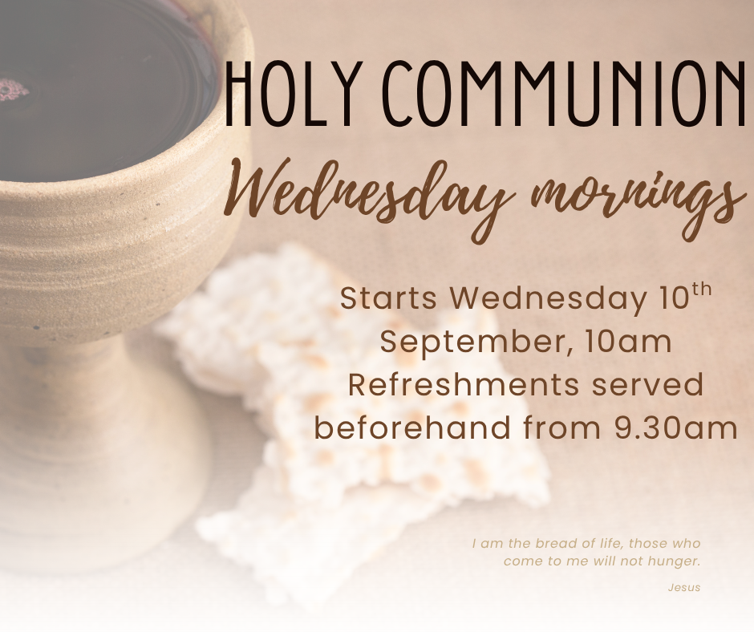

Slide 3



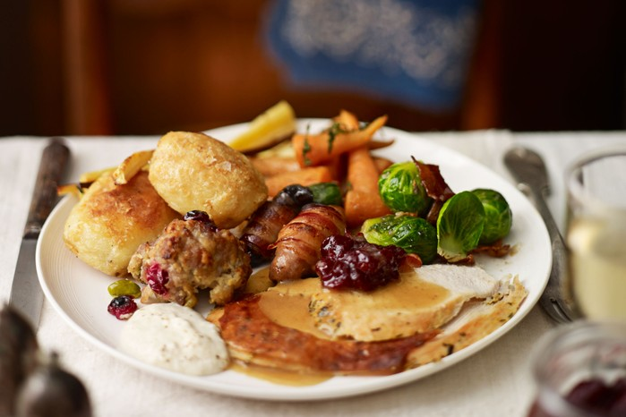

Christmas Lunch Club
Thursday 18th December
· Turkey, ham and all the trimmings
· A choice of seasonal home made desserts
Just a few spaces left, please see Yvonne.

Slide 4
Weekly Lunch Club
Is also on every Thursday in the Old Schoolroom at 12 noon.
~Friendly chat, soup, choice of 4 sandwiches made to order and cake or dessert. Light- hearted quiz. Very easy going. No need to book.
Only £4 per head

Slide 5


Slide 6


All donations towards our Church Christmas Tree or gifts of wine for mulled wine at our various events gratefully received.
Please speak to Colin
This Photo by Unknown Author is licensed under CC BY
This Photo by Unknown Author is licensed under CC BY-NC

Slide 7
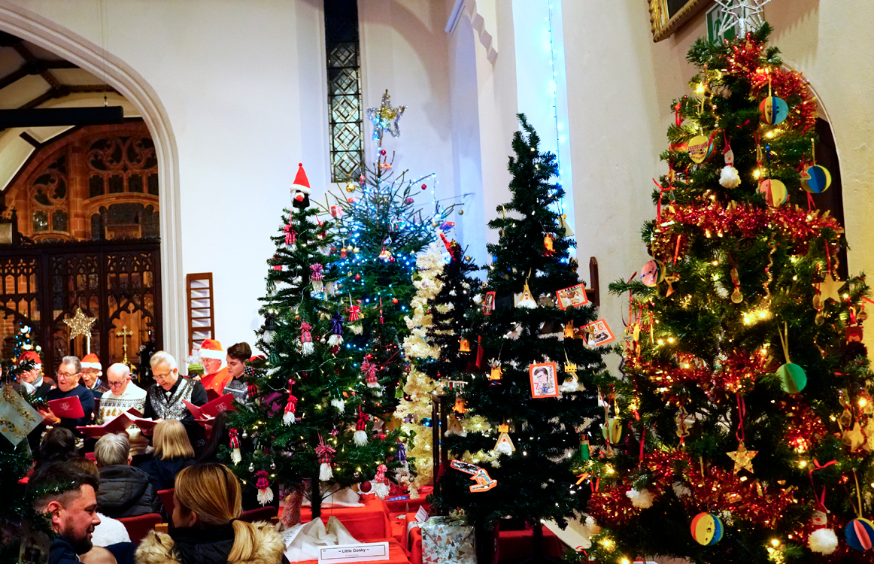
Our Christmas Tree Festival is next weekend
Please sign up to help meet and greet or serve refreshments, make a cake or donate a bottle of wine. All help gratefully received.

Slide 8
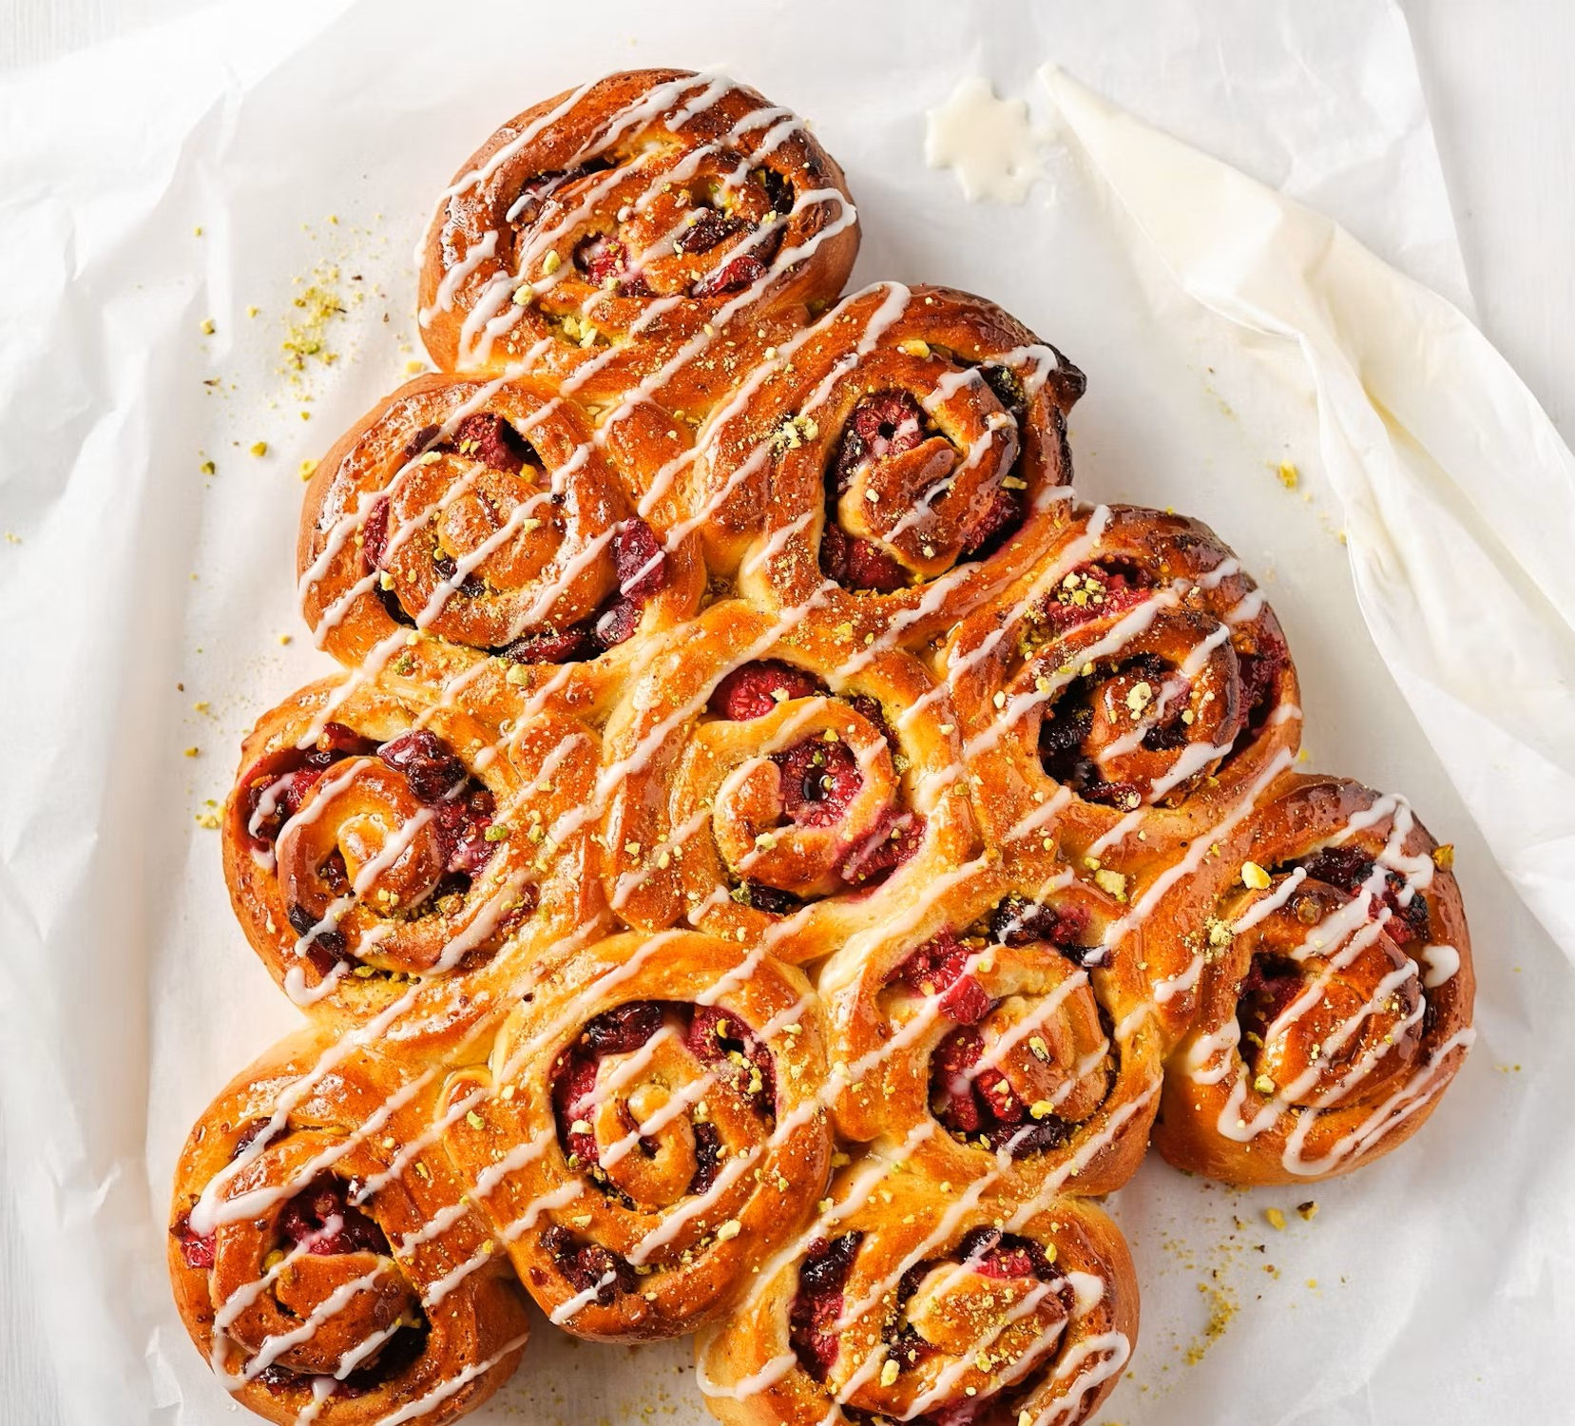
Knead next meets on 13th December from 10am to 12 noon in Rayne Church
We are making a Chelsea Bun Christmas Tree
All welcome
£ 4 (Under 16s free)
We will be making foccacia

Slide 9
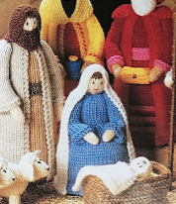
POSADA
Joseph and Mary will be knocking on your door soon
We will send the woollen figures of the holy couple around the village seeking for hospitality again this year.
Will you receive them in your homes?
Please speak to Michele Harris if you want to give shelter.

Slide 10

Please tell your friends and neighbours about our church 100 Club.
Money raised supports our roof appeal.

Slide 11

A 2 year course.
Meeting locally on Weds. evenings
Starts in January
Contact Roman if you are interested

Slide 12
Rayne Sunday Services: all at 9.30 am
1st Sunday: Communion with choir
2nd Sunday: All-Age Worship
3rd Sunday: Communion
4th Sunday: Morning Prayer
5th Sunday: Benefice Service in one of the 3 churches
Everybody is welcome

