Slide 1

What’s Ahead for Rayne
Church
^{6th September 2026}

Slide 2

Over the summer we have gifted 506 picnic lunch bags to primary school children and their younger siblings
Huge thanks to all our donors and volunteers. The next Picnic in the Park will be in October half term

Slide 3

Wednesday mornings in Rayne church
10 a.m.

Slide 4
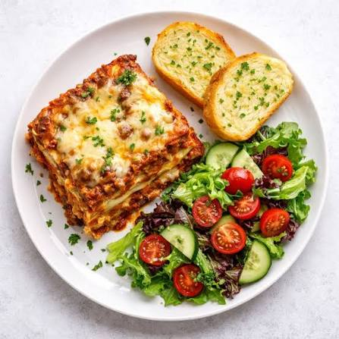
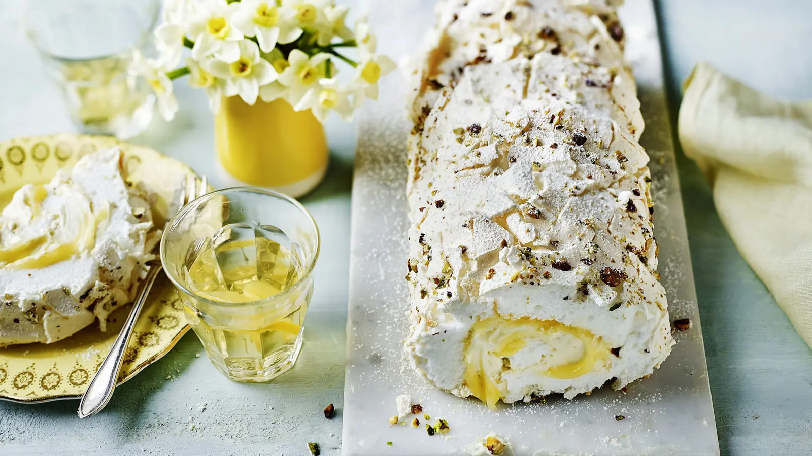
Lunch Club
Thursday 10th September 2026
12.00 for 12.30 £7
Speak to Kate to book a place
Beef Lasagne and salads
Lemon Roulade

Slide 5
Weekly Lunch Club
Is also on every Thursday in the Old Schoolroom at 12 noon.
~Now serving our summer menu. Friendly chat, light- hearted quiz. Very easy going. No need to book.
Only £5 per head

Slide 6


Slide 7



Slide 8
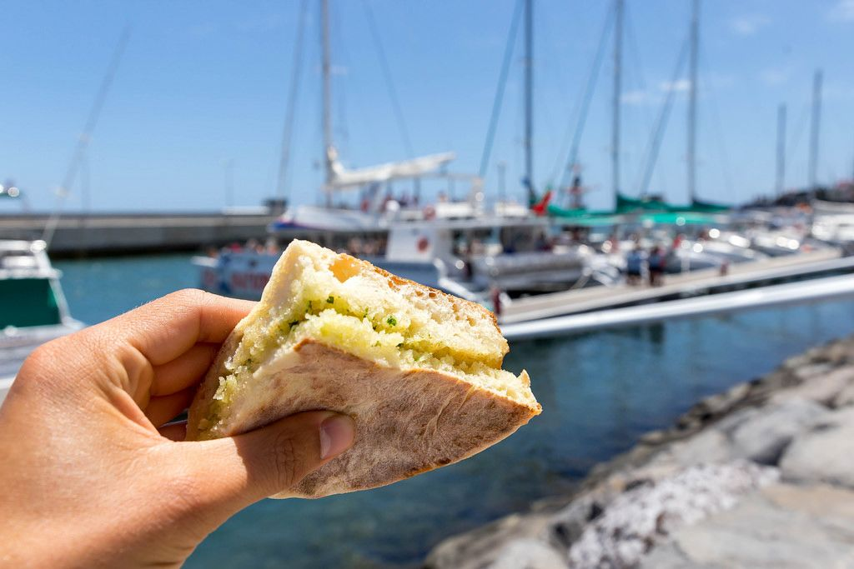
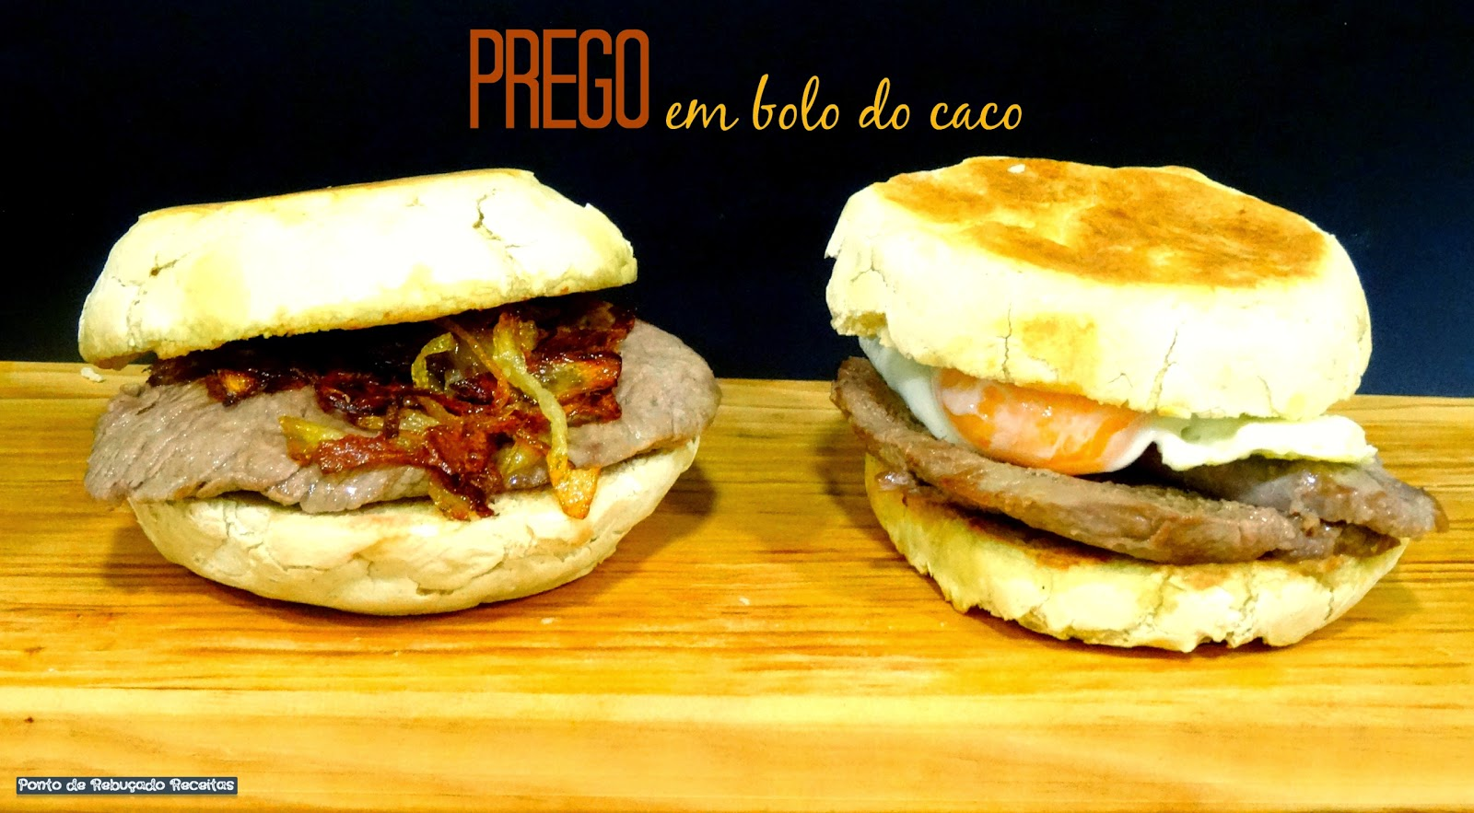
KNEAD
Saturday 12th September
10am to 12 noon,
Rayne Church
Speak to kate to book a place
We are making the Traditional Madeiran flatbread bolo do caco
This Photo by Unknown Author is licensed under CC BY
This Photo by Unknown Author is licensed under CC BY-NC

Slide 9
Rayne Sunday Services:
all at 9.30 am
1st Sunday: Communion with choir
Time to Be
2nd Sunday: All-Age Worship
3rd Sunday: Communion
4th Sunday: Morning Prayer
5th Sunday: Benefice Service in one of the 3 churches
Everybody is welcome

